Slide 1



Solace Performance Testing Harness
Christian Holtfurth
30/04/2026

Slide 2
Purpose
Easy validation of broker infrastructure against benchmarks
Identify throughput capacity of a broker on infrastructure of unknown or unqualified performance.
Run custom tests to determine throughput for specific business scenarios (message size and fanout).
Feed into capacity planning and identify potential bottlenecks before they become an issue.
Supports AI tools and skills to be used by an LLM like Claude Code.

Slide 3
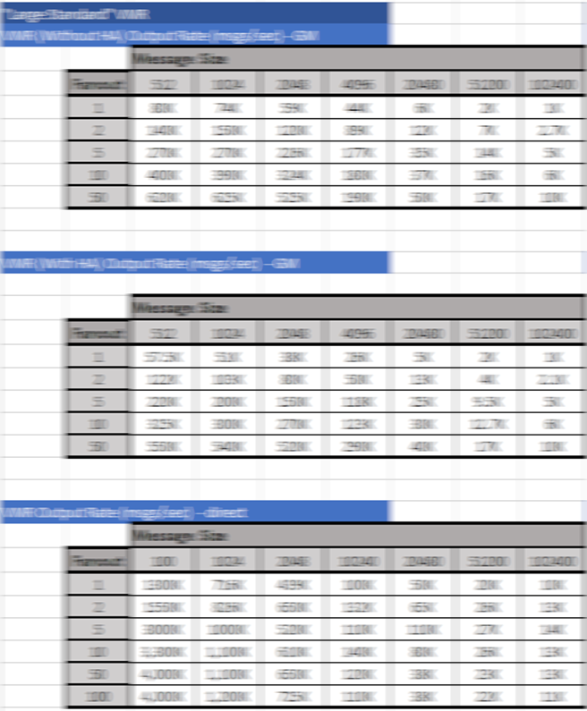
The Problem
Performance testing isn’t easy.
And gathering a full set of performance metrics on a broker manually takes a lot of time:
Lot of tests with varying message sizes and fan-out ratios as well as different message types
Each test needs to be run for a min amount of time to make sure we are not using burst credits or spooling etc.
Lot of virtual hardware sizes to choose from and run tests on
Sdkperf needs to be run across several hosts spreading traffic across several topics as single host setups can not push enough data through broker alone.

Slide 4
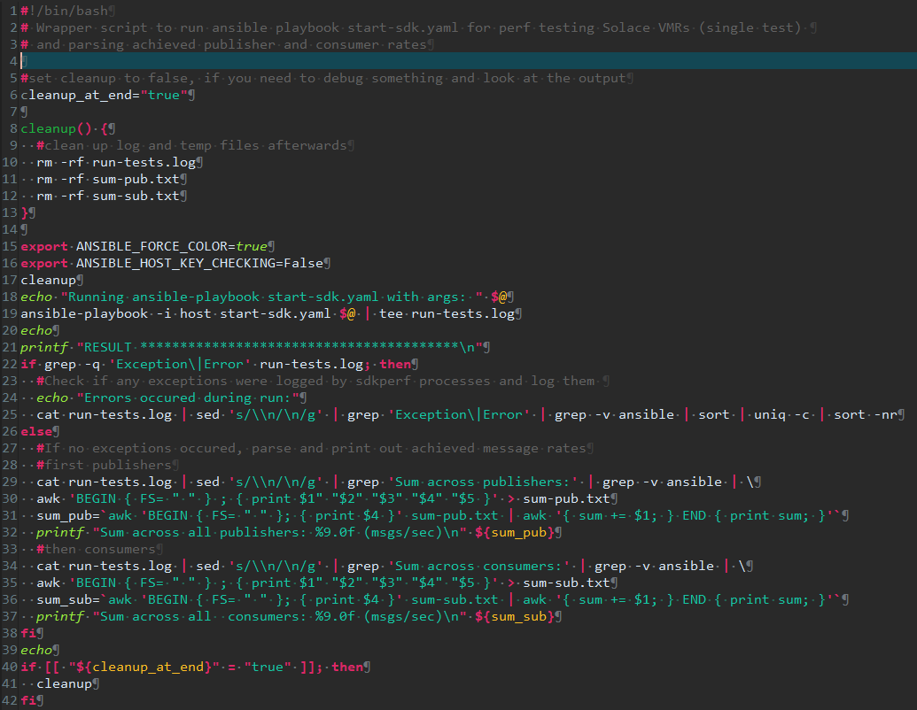
The Solution: Automation via Shell Scripts and Ansible
Use a combination of:
Timed sdkperf publisher and consumer scripts
Ansible playbook with asynchronous actions and polling to spin up sdkperf instances across several performance testing hosts and collect results
Some bash, grep, awk, sed script magic to collect and calculate results and analyze for common bottlenecks.
Wrapper scripts to make it re-usable

Slide 5
Overview of test setup
Ansible controller host runs the main scripts and ansible playbook, which:
Pushes the Sdkperf files and scripts to the publisher and subscriber hosts
Starts the Sdkperf consumers and publishers in async jobs with a timer
Collects the results from all hosts and calculates the overall message throughput
Decides whether test is success or fail based on target throughput number
SSH
Ansible
Controller
Host
Pubhost1
SMF
Subhost1
Pubhost2
Subhost2
Pubhost3
Subhost3
Pubhost4
Subhost4

Slide 6
Test set script formats
1) Benchmarking: Fixed-target format (benchmarking-tests/*.sh):
msg_size : fanout : overall_consumer_rate : parallel_pub_hosts : msg_type
overall_consumer_rate already includes fanout; runner divides by (hosts × fanout) to get per-pub rate
2) Discovery format (discovery-tests/*.sh / custom-sets/*.sh):
msg_size : fanout : parallel_pub_hosts : msg_type
No rate needed — run-binsearch-testset.sh finds the maximum automatically

Slide 7
When you don’t know what to expect: run-binsearch-testset.sh
Discovery mode: automatically finds the maximum stable throughput for each test scenario.
Phase 1 — Exponential probe:
Starts at upper_bound / 1024 and doubles the rate each iteration
Stops when the broker fails to sustain the target rate (first bracket found)
Phase 2 — Binary search:
Bisects the passing/failing bracket until precision reaches ±1%
Default: up to 10 search iterations, 60 s run-length per step
Configurable upper bounds (export before calling the runner):
search_upper_bound_direct (default 5,000,000 msgs/s)
search_upper_bound_nonpersistent (default 2,000,000 msgs/s)
search_upper_bound_persistent (default 1,000,000 msgs/s)
Calls analyse-result-set.sh automatically on completion.

Slide 8
analyse-result-set.sh
Parses result files after each test run and identifies likely bottlenecks.
Usage:
engine/analyse-result-set.sh 1k_mixed (by shorthand)
engine/analyse-result-set.sh results/foo.txt (by path)
engine/analyse-result-set.sh results/my-run/ (all files in directory)
engine/analyse-result-set.sh (scan entire results/ tree)
Diagnostic checks performed:
CPU saturation — clock errors indicate broker is CPU-bound
Publisher bottleneck — flat pub rate means publishers are the limit
WAN/NIC bandwidth — checks whether consumer or producer NIC is the ceiling
Partial host contribution — detects when not all pub hosts are contributing
IOPS constraints — persistent tests hitting EBS / NVMe write limits
Fanout delivery gaps — consumer totals don't match expected fanout
Both runner scripts (run-testset.sh and run-binsearch-testset.sh) call it automatically.

Slide 9
The Framework
Ansible Controller Host
Subhost
engine/start-sdk.yaml
Ansible playbook
- Pushes sdkperf and scripts to pub/sub hosts
- Starts the sdk_consumers across all subhosts
with a timer in an async job
- Starts the sdk_publishers across all pubhosts
with a timer in an async job
(each host get a portion of the target msg
rate assigned = overall / no of hosts)
- Collects the output of all publisher and
consumers across all hosts
start-benchmarking-test.sh
Interactive menu for pre-defined benchmarking testsets
start-standard-discovery-test.sh
start-custom-discovery-test.sh
Discovery mode entry points; wizard builds custom testsets
custom-sets/*.sh | benchmarking-tests/*.sh
Define test scenario arrays directly
sdkconsumers.sh
- Starts number of requested sdkperf consumers and pins them to
cores (no of publishers * by fanout) in background
- Waits for timer to expire or Control-C, which is then caught to
gracefully kill the sdkperf jobs and allow for their output to be
written
- Collects the results for each sdkperf job and calculates sum
Pubhost
sdkpublisher.sh
- Starts number of requested sdkperf publishers and pins them to
cores in background (each with a portion of the host target msg
rate = host rate / no of publishers)
- Waits for timer to expire or Control-C, which is then caught to
gracefully kill the sdkperf jobs and allow for their output to be
written
- Collects the results for each sdkperf job and calculates sum
engine/run-testset.sh
Fixed-target mode: validates each scenario hits a pre-defined rate within 5% margin
engine/run-binsearch-testset.sh
Discovery mode: exponential probe + binary search to find max stable throughput
engine/run-test.sh
Wrapper script around ansible
playbook:
- Calls ansible playbook
- Collects results from all hosts
- Calculates overall sum

Slide 10
read -p “Questions?" question
while [ ! -z “${question}”] ; do
answer ${question}
read -p “Next question?" question
done

Slide 11
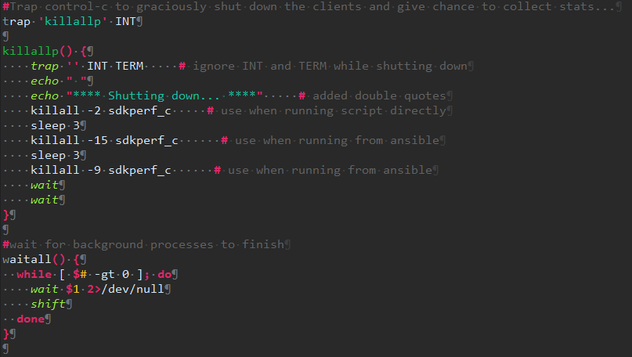
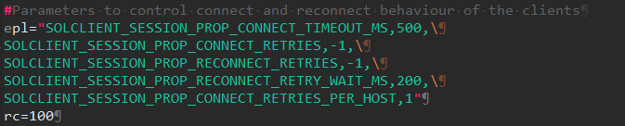
sdkconsumers.sh & sdkpublishers.sh

Slide 12
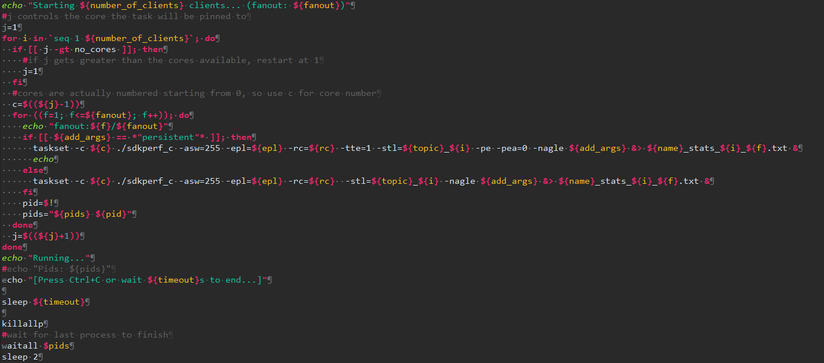
sdkconsumers.sh

Slide 13
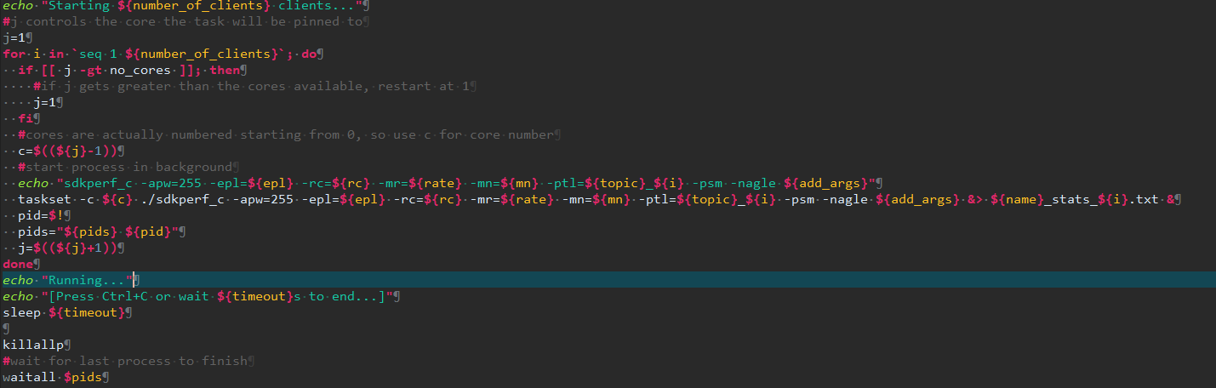
sdkpublisher.sh

Slide 14
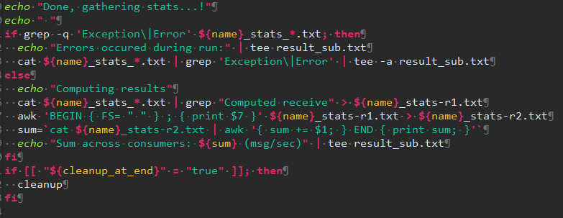
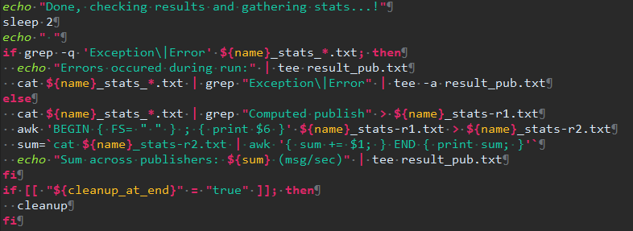
sdkconsumers.sh & sdkpublisher.sh

Slide 15
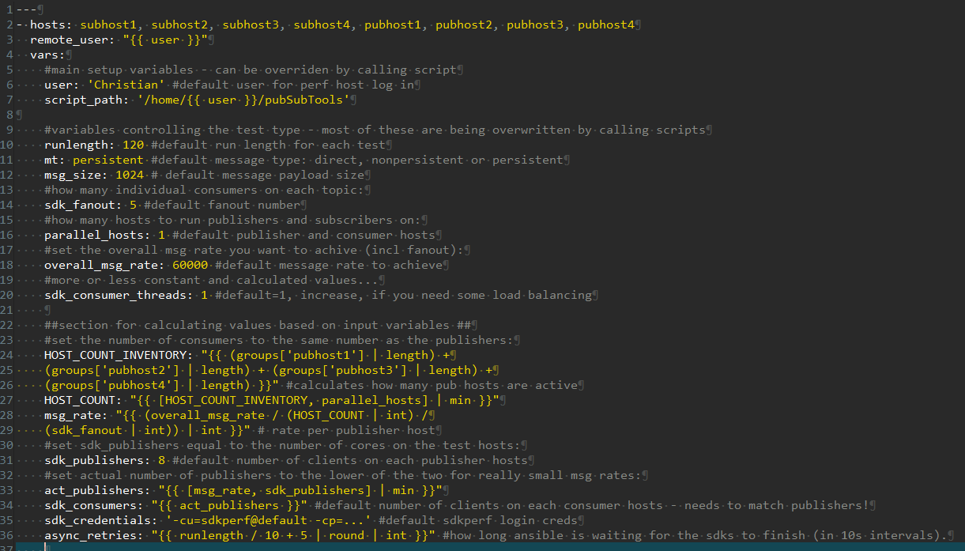
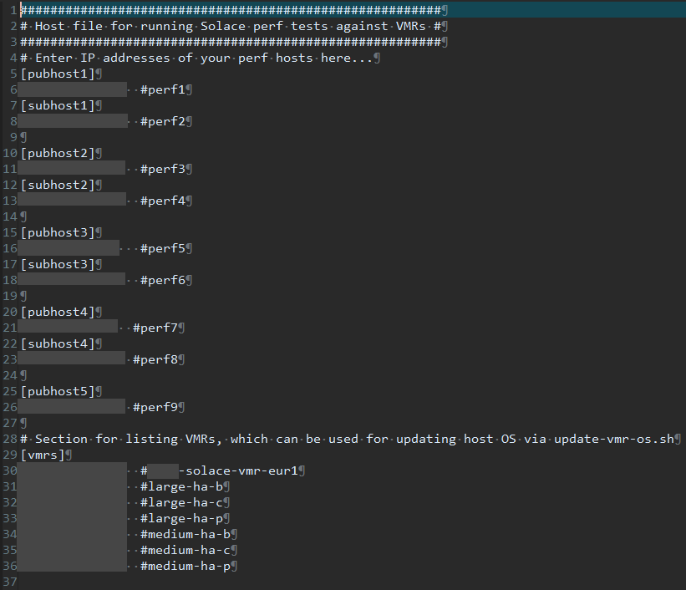
start_sdk.yaml

Slide 16
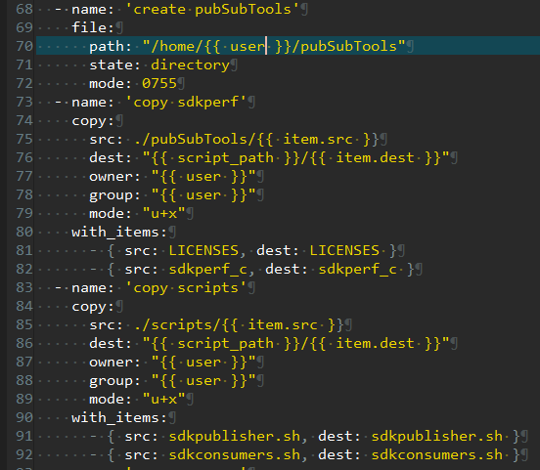
start_sdk.yaml
Just a bit of pre-test setup…
Create directories
Copy scripts over
Make them executable

Slide 17
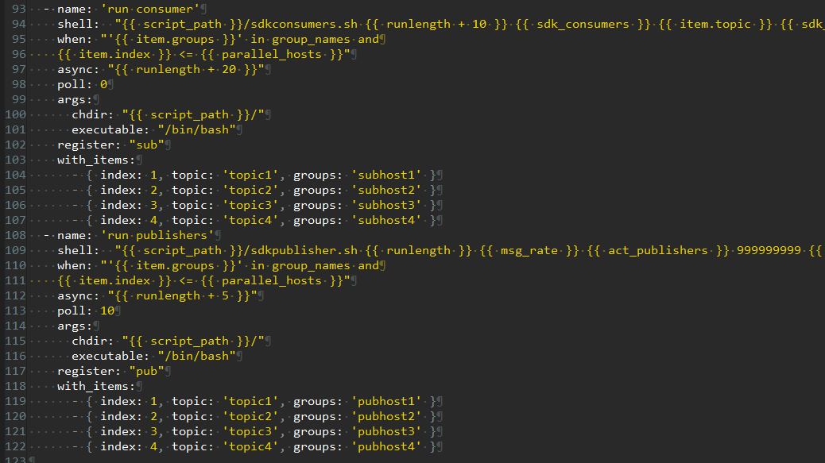
start_sdk.yaml
Starting sdks…
async with runlength
poll: 0 = fire & forget
poll: 10 = wait for it
item.index <= p. hosts
with_items: each host with different topic
register: to collect
output later

Slide 18
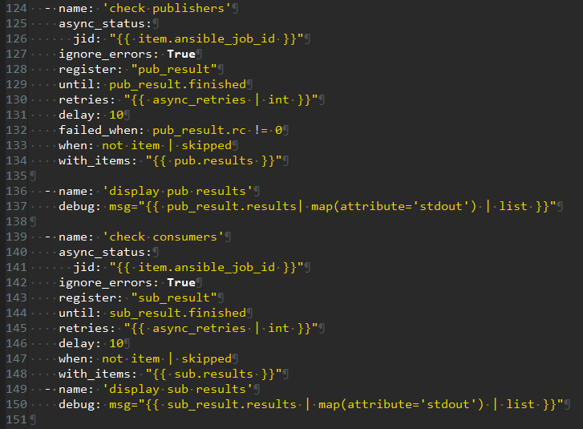
start_sdk.yaml
Collecting it…
Tries to collect the results of the async jobs every 10 s for a previously calculates no of time
Ignore_errors: True Don’t worry, we’ll do our error handling in the wrapper scripts

Slide 19
run-test.sh
Just a wrapper around the ansible playbook for mainly:
Running a single test
Calculating overall throughput numbers
And: Error handling!

Slide 20
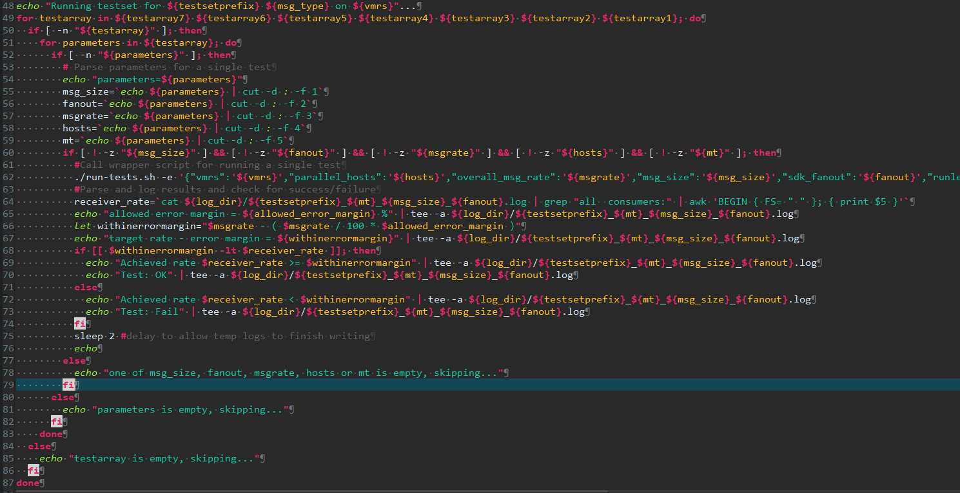
run-testset.sh
Fixed-target test runner — loops over test scenario arrays and validates each one hits its target rate.
For each scenario (msg_size : fanout : target_rate : pub_hosts : msg_type):
Calls engine/run-test.sh → ansible-playbook → remote pub/sub scripts
Compares achieved rate vs. target; pass/fail within 5% margin (configurable)
Writes a structured result file to results/{prefix}_{type}_result.txt
Supports up to 7 test arrays in one invocation (separated by ; delimiter).
After all arrays complete:
Prints a pass/fail summary table
Automatically calls engine/analyse-result-set.sh to diagnose bottlenecks

